Slide 1

A SEMINAR PRESENTATION on HYDROLOGICAL MODELLING OF AN AQUIFER AND THEIR GROUNDWATER POTEENTIALS BY EZECHE UCHENNA KINGSLEY 170812033 ON TUESDAY,MARCH 19TH,2024

Slide 2

CONTENTS
INTRODUCTION.
GROUNDWATER RESOURCE.
HYDROLOGY AND HYDROLOGIC CYCLE.
AQUIFER CHARACTERIZATION.
HYDROLOGIC MODELLING TECHNIQUE FOR AQUIFERS.
DATA ACQUISITION AND MODEL DEVELOPMENT.
SOFTWARES MODELS AND TOOLS.
INTEGRATION OF MODELLING TECHNIQUE.
APPLICATION AND LIMITATION OF HYDOLOGIC MODELLING.
CONCLUSION.

Slide 3
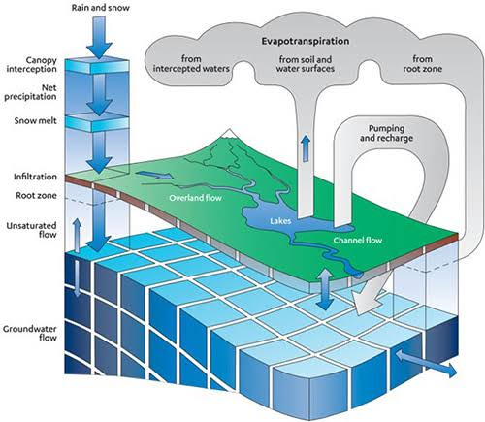
INTRODUCTION
Groundwater, an hidden treasure beneath our feet, sustains
Life and ecosystems across the globe and it is an integral system in hydrologic modelling. However, managing this vital resource effectively requires a deep understanding of its behavior and potentials. Hydrologic modelling is an important tool simulating the movement, and behavior of groundwater within an aquifer system. Different question regarding the storage of groundwater, its movement, response to natural variation and human activities within the aquifer, factors influencing groundwater potentials and their numerous challenges will be assessed and reviewed.

Slide 4
AIMS AND OBJECTIVES
Understanding hydrologic processes and Aquifer system.
Assessment of Groundwater potentials.
Analyzing the impact of natural phenomenon and human activities on aquifer system and groundwater potentials.
Introduction on the various hydrologic modelling approaches and software available for groundwater assessment and management.
Understanding the role of hydrologic modelling in formulating effective groundwater management strategies , policies and regulations.

Slide 5
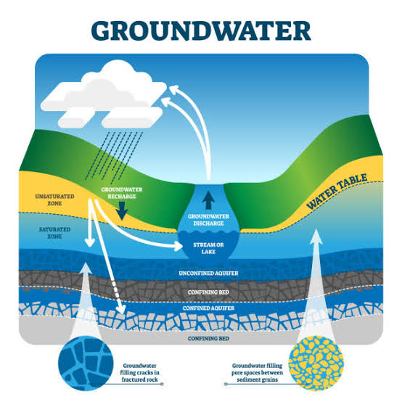
GROUNDWATER RESOURCES
Groundwater is the water present beneath Earth’s surface in a rock and soil pore spaces and in the fracture of rock formations. 30% of the available freshwater in the world is groundwater and 0.76% of the entire world’s water including oceans and permanent ice.
CHALLENGES
Overexploitation
Water quality
Deterioration
Land subsidence
Sea water intrusion

Slide 6
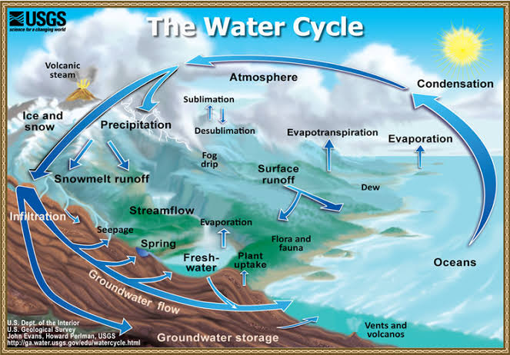
HYDROLOGY AND HYDROLOGIC CYCLE
Hydrology is the scientific study of the movement, distribution and management of water on the Earth, including the Water cycle, water resources and environmental sustainability water shed.
Hydrologic cycle is the movement of water on, above and below the Earth surface.

Slide 7
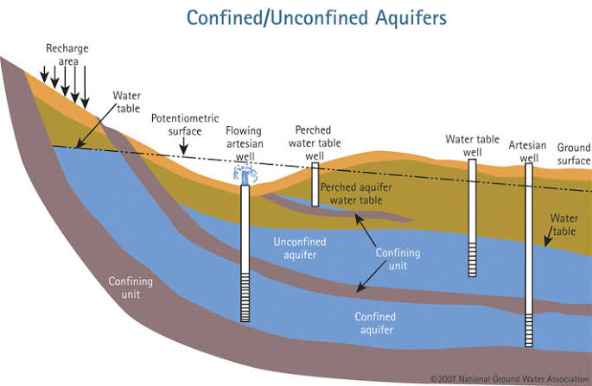
aquifer characterization

Slide 8
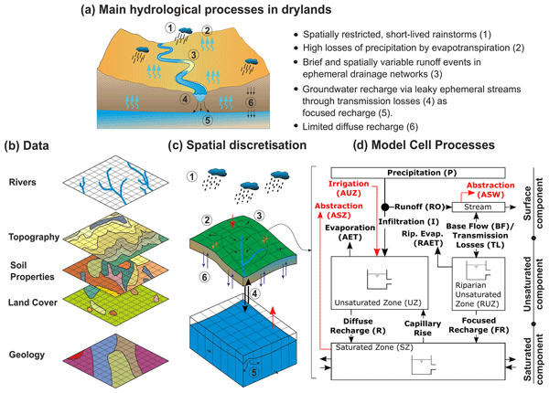
Hydrologic modelling
Hydrologic Modelling are mathematical tools that stimulate the movement and behavior of groundwater within an Aquifer system. A hydrologic model stimulate a flux, flow or change in water storage with time within one or more components of the natural hydrological cycle.

Slide 9
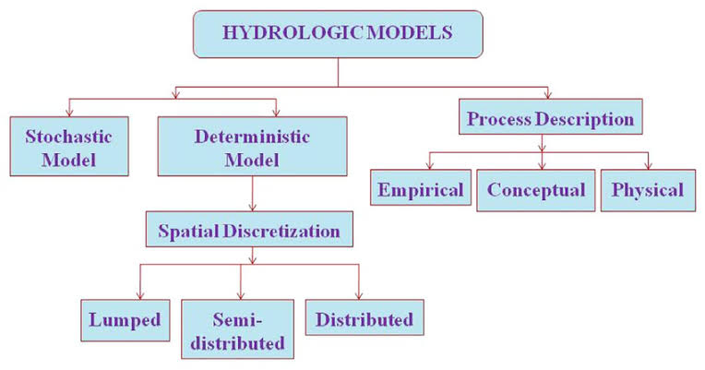
TYPES OF HYDROLOGIC MODELLING

Slide 10
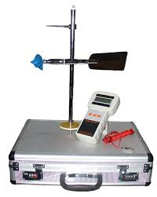
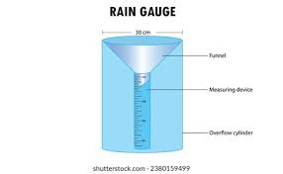
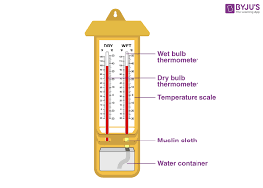
Data acquisition and technique
(a)Current meter for stream flow velocity
(b) Rain gauge for precipitation measurement
(c) Hygrometer for relative humidity measurement

Slide 11
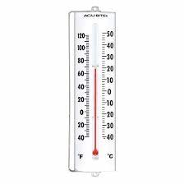
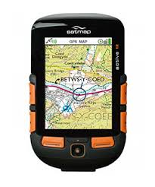
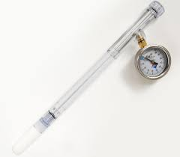
DATA ACQUISITION AND TECHNIQUE
(d) Thermometer for temperature measurement
(e)Tensiometer for soil moisture measurement
(f) GPS for locating position of data collection point

Slide 12
field data acquisition procedure
FIELD DATA ACQUISITION
PLANNIG AND SITE SELECTION
EQUIPMENT SELECTION/ CALIBERATION
DATA COLLECTION
DATA QUALITY CONTROL
DATA MANAGEMENT

Slide 13
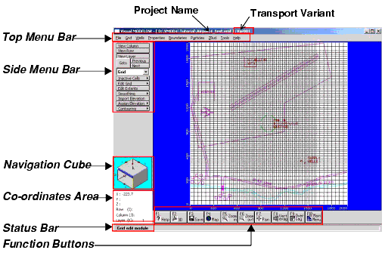
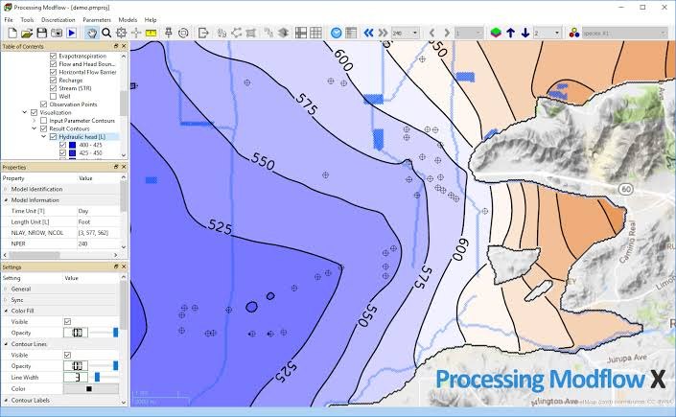
MODELLING SOFTWARES AND TOOLS
. MODFLOW – ( MODULAR FINITE – DIFFERENCE GROUNDWATER FLOW)
(a) Visual display of a MODFLOW software
(b) Groundwater potentials of different layers

Slide 14
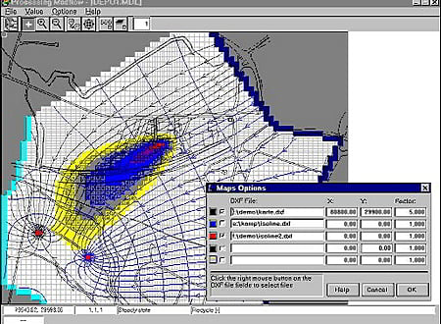
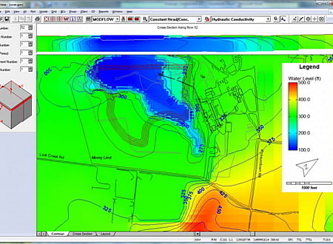
MODELLING SOFTWARE AND TOOLS
(c) Solute transport system
(d) Groundwater level of different layers

Slide 15
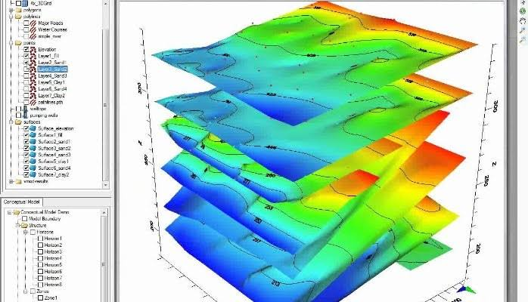
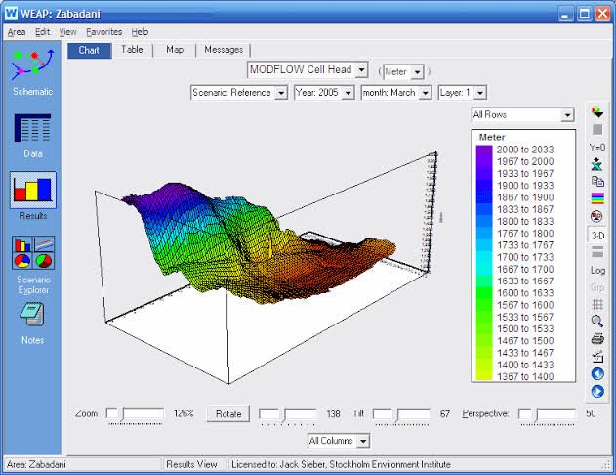
modelling software and tools
(e) Aquifer properties of different layers
(f) Hydrologic view of a particular layer

Slide 16
INTEGRATION OF HYDROLOGIC MODEL
MODFLOW + HSPF
MODFLOW stimulate saturated groundwater process
HHSPF stimulate surface and vadose zone processes
HHSPF – Hydrologic Simulation program FORTRAN. MODFLOW - Modular finite – difference Groundwater flow.

Slide 17
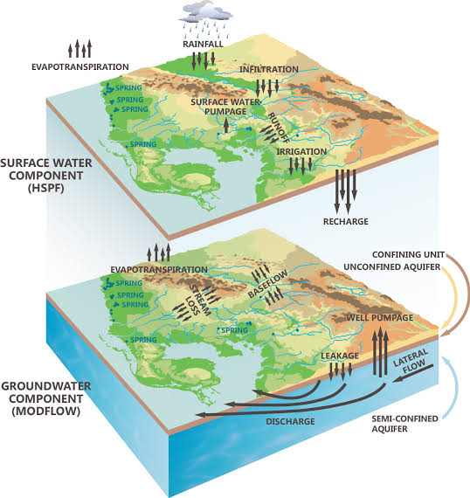
INTEGRATION OF HYDROLOGIC MODEL

Slide 18
APPLICATION OF HYDROLOGIC MODELLING
HHYDROLOGIC MODELLING
WATER RESOURCE MANAGEMENT
ENVIRONMENTAL IMPACT ASSESSMENT
DISASTER PREPAREDNESS AND MITIGATION
ECOLOGICAL FLOW MANAGEMENT

Slide 19
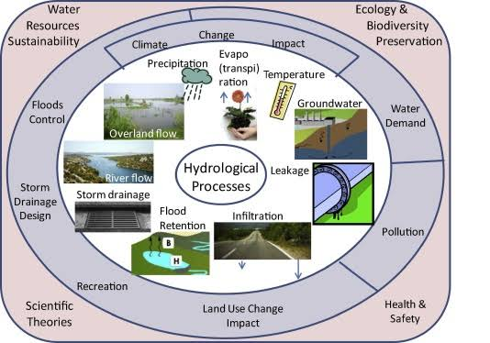
Application of hydrologic modelling

Slide 20
LIMITATIONS OF HYFROLOGIC MODELLING
Spatial and Temporal limitations.
Complexity vs Accuracy.
Limited data availability.
Measurement Errors.
Non – physical processes.
Model structure Uncertainty.

Slide 21
CONCLUSION
Hydrologic modeling of aquifers is a powerful technique for assessing and managing groundwater
resources. These models act as virtual representations of the underground water system, simulating
how water flows through the aquifer and interacts with the surrounding environment. Aquifer
modelling has become an indispensable tool for understanding and managing groundwater resource
While current models provide valuable insights, advancements in computational
power, data acquisition, and modeling techniques promise significant progress in the future.
We can expect to see high-resolution models that capture finer details of aquifer
properties, along with the ability to simulate complex processes like contaminant
transport and land subsidence. Integration of remote sensing, big data analytics,
and improved monitoring technologies will provide a more comprehensive picture
of aquifer health. Machine learning and AI will likely play a growing role in model
development, leading to more robust predictions and a deeper understanding of
aquifer behavior.

Slide 22
THANKS FOR LISTENING!!!

